Slide 1
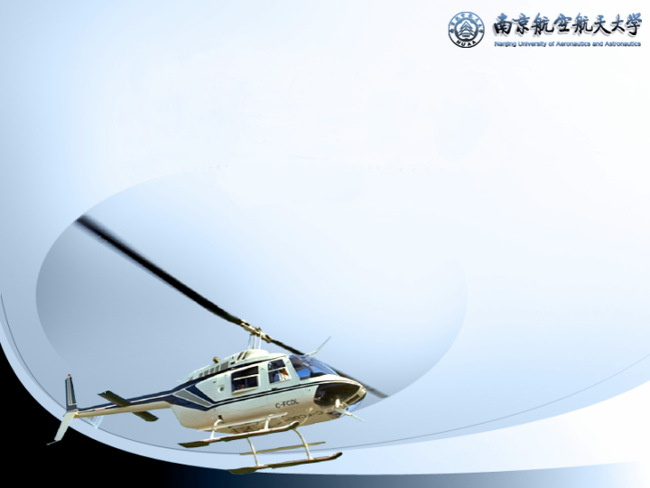
Chapter 4
Gas Turbine Jet Engines

Slide 2

Ch 4 Gas turbine jet engines
§4.1 Matching of the components
  1. Matching conditions
  2. Adjustment rule discussion
  3. Working line
§4.2 Characteristics
  1. Rotation characteristics
  2. Speed characteristics
  3. Altitude characteristics
  4. Transient states

Slide 3
Ch 4 Gas turbine jet engines
§4.3 Generic performance and test bench equivalent
  1. Similitude
  2. Generic jet engine characteristics
  3. Test bench equivalent
§4.4 Twin spool jet engines
  1. Twin spool engine working
  2. Matching
  3. Adjustment rule and characteristics

Slide 4
Ch 4 Gas turbine jet engines
§4.5 Jet engine with afterburner
  1. Afterburner characteristics
  2. Adjustment rule and characteristics
  3. Water injection

Slide 5
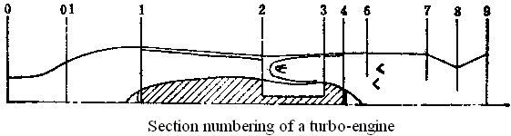
§4.1 Matching
Elements working together
F and sfc variation vs speed, altitude and rotational speed.
Steady characteristics
Transient characteristics
Ex. Single spool

Slide 6
§4.1 Matching
1. Matching conditions
  Flow continuity in sections（5 eq.）
  Energy balance in sections（5 eq.）
  Pressure relations（5 eq.）
  Element characteristics（7 curves）
  22 equations in total
Notes:
22 functions and 26 variables

Slide 7
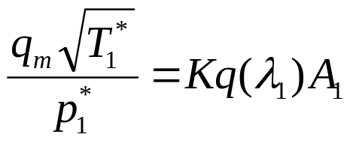
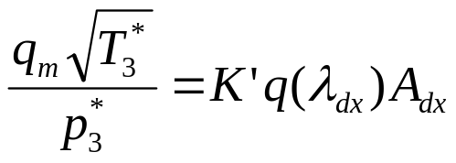
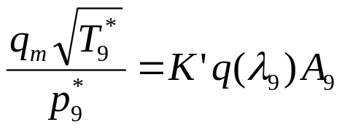
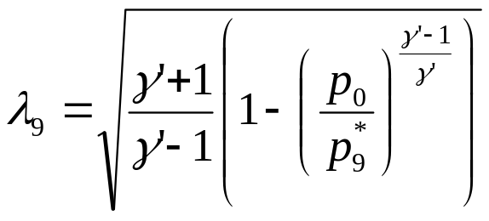
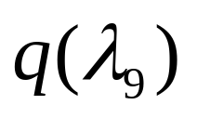
Flow continuity
  Compressor inlet
  NGV outlet
  Nozzle throat（Con）
  If not critical

Slide 8

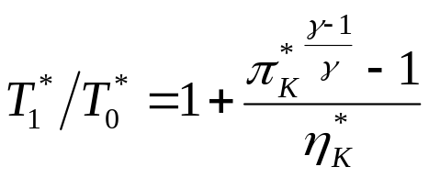
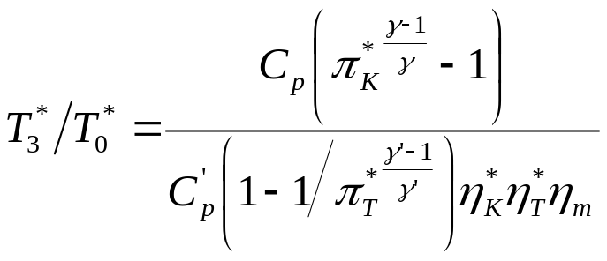
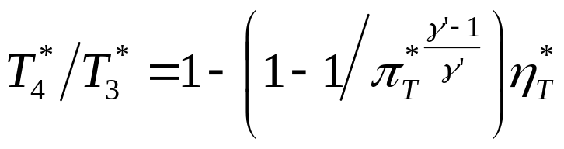

Energy balance
In intake
Compressor outlet
Turbine inlet
Turbine outlet
Nozzle（w/t afterburner）

Slide 9
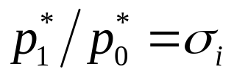
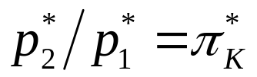
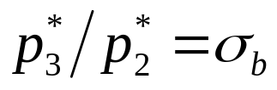
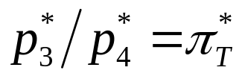
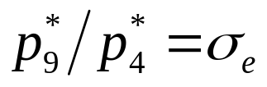
Pressure relations
Intake
Compressor
Combustor
Turbine
Nozzle

Slide 10
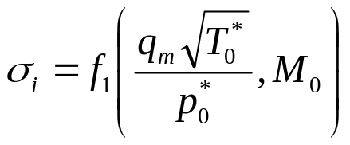
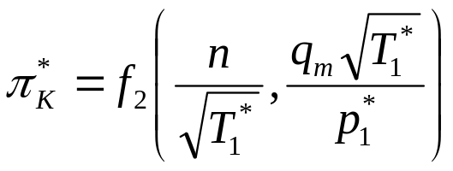
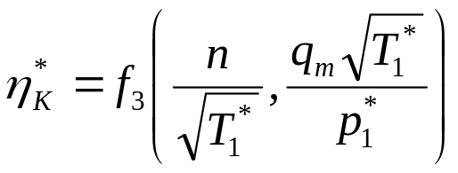
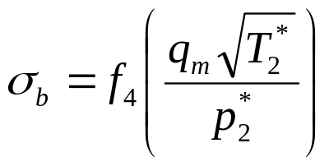
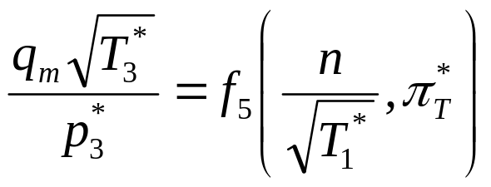
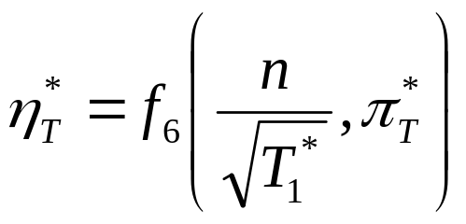
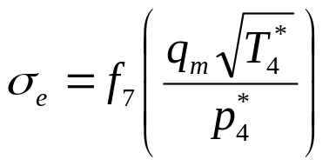
Element characteristics
Inlet
Compressor
Combustor
Turbine
Nozzle

Slide 11
1. Matching conditions (Cont’d)
  26 variables：q(λ₁)，q(λ_{dx})，q(λ₉)，λ₉，T₀*，T₁*，T₂*，T₃*，T₄*，T₉*，p₀，p₀*，p₁*，p₂*，p₃*，p₄*，p₉*，σ_{i}， π_{C}*，η_{C}*， σ_{b}， π_{T}*，η_{T}*， σ_{e}， q_{m}，n
Notes:
22 functions and 26 variables

Slide 12
1. Matching conditions (Cont’d)
  Other variables： M₀，H
  Function, p₀= f(H)
Total 24 equations, 28 variables
  Add regulation rule（1 eq.）
  3 independent variables：n, M₀, H

Slide 13
1. Matching conditions (Cont’d)
T₀*，p₀，p₀*，n
T₀*，p₀，p₀* vary with altitude, speed
  If n and M unchanged, under a regulation rule, inlet parameters’ changes due to altitude influence engine’s performance. This is the altitude characteristics.
Notes:
T₀*，p₀，p₀*，n
T₀*，p₀，p₀* 是随着飞行高度、速度变化的，所以
n一定，飞行M数一定，在给定调节规律下，由于不同高度进口参数的变化，从而引起发动机性能的变化，就是高度特性。

Slide 14
1. Matching conditions (Cont’d)
T₀*，p₀，p₀*，n
T₀*，p₀，p₀* vary with altitude, speed
  If n and H unchanged ，under a regulation rule, inlet parameters’ changes due to M₀ influence engine’s performance. This is the speed characteristics.
Notes:
T₀*，p₀，p₀*，n
T₀*，p₀，p₀*是随着飞行高度、速度变化的，所以
n一定，飞行高度一定，在给定调节规律下，由于不同M数引起发动机性能的变化，就是速度特性。

Slide 15
1. Matching conditions (Cont’d)
T₀*，p₀，p₀*，n
T₀*，p₀，p₀*vary with altitude, speed
  If H and M₀ unchanged ，under a regulation rule, n change by giving fuel influences engine’s performance. This is rotational speed characteristics.
Notes:
T₀*，p₀，p₀*，n
T₀*，p₀，p₀*是随着飞行高度、速度变化的，所以
高度、速度都不变，在给定调节规律下，随着n的变化，即改变供油量，从而引起发动机性能的变化，就是转速特性。

Slide 16
§4.1 Matching
2. Adjustment rule discussion
  Why adjustment
    For pilots, power can be changed.
    For engines, n, T₃*, bleeding devices, nozzle area can be changed.
Notes:
二、调节规律的讨论
什么可以调？
对飞行员，只有油门、加力。油门杆的变化会引起 n、T₃*的变化。
对发动机，放气带、喷口截面积。

Slide 17
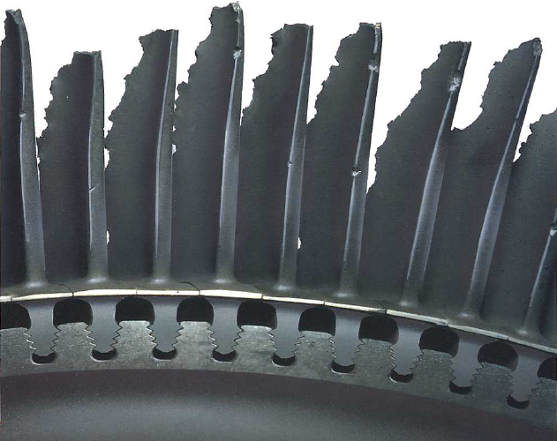
2. Adjustment rule (Cont’d)
  Rotational speed limited by material resistance
  T₃* ⇒ turbine vanes and blades
  Aircraft engine adjustment system very complicated
    n adjustor
    T₃* adjustor
Notes:
转速影响强度
T₃*影响涡轮叶片
发动机的控制系统很复杂
转速调节器
T₃*调节器

Slide 18
2. Adjustment rule (Cont’d)
p₀* infects only p* at all sections and mass flow, not T*, similitude or specific parameters
T₀* infects T*, and all similitude or specific parameters
Notes:
p₀* 只会影响发动机沿流程各处的总压和流量，不影响总温和所有的相似参数及单位参数。
T₀*影响总温和所有的相似参数、单位参数和推力。
可用A₈调节T₀*的影响。

Slide 19
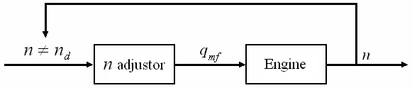
2. Adjustment rule (Cont’d)
2.1 n and nozzle area unchanged, allow T₃* changing
Notes:
1，最常用
3，最佳

Slide 20
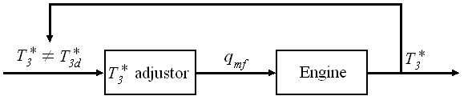
2. Adjustment rule (Cont’d)
2.2 T₃* and nozzle area unchanged, allow n changing
Notes:
1，最常用
3，最佳

Slide 21
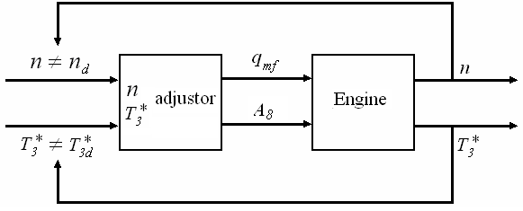
2. Adjustment rule (Cont’d)
2.3 n and T₃* unchanged, allow nozzle area changing
Notes:
1，最常用
3，最佳

Slide 22
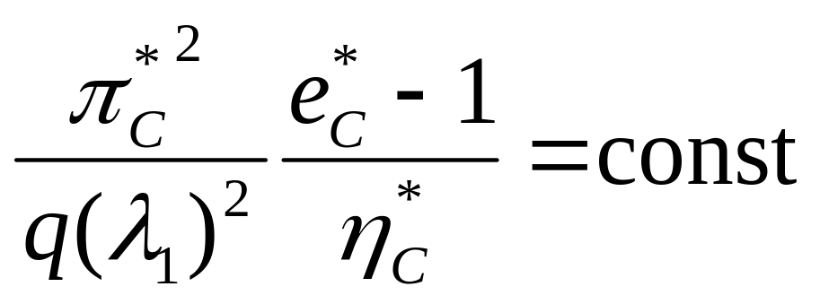
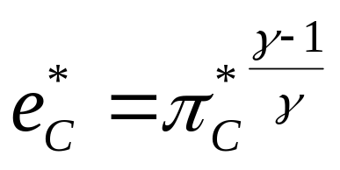
§4.1 Matching
3. Operating line
Ex：Compressor-turbine matching
  Flow continuity
  Power equal
  π_{T}* constant

Slide 23
3. Operating line (Cont'd)
3.1 Operating line significance
  The Operating line is drawn in performance map of compressor using similitude parameters so that it is generic. When an engine (geometry invariable) works with A₈ critical state, working point is always on this line regardless rotation, altitude and speed changes. n／√T₁* determines the working point.
Notes:
几何不变——一条工作线

Slide 24
3.1 Operating line significance (Cont'd)
  On the working line, for a given n／√T₁*, q_{m}√T₁*／p₁* (or M₁) is determined. With different flying Mach number M₀, the intake must provide a mass flow (or M₁) required by the engine. That is why we need an intake and its adjustment.
Notes:
进气道的作用

Slide 25
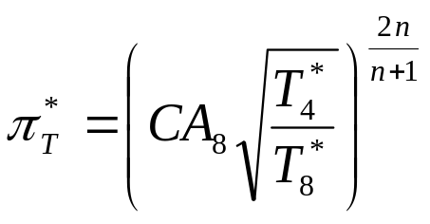
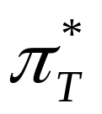
3. Operating line (Cont'd)
3.2 Operating line influenced by nozzle critical section
  If reducing the critical section A₈ (change geometry) and (n／√T₁* ) unchanged, then:
  p₄↑ (after turbine) means ↓ , W_{T}↓, may ↓n.
Notes:
同一型号，不同台份（新旧），试车台上调整A8。

Slide 26
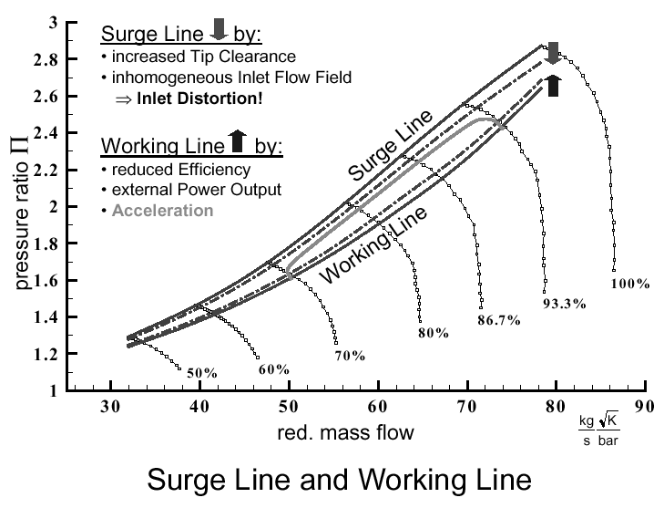
3.2 Nozzle critical section (Cont'd)
  We wan n constant, need to add more fuel and T₃*↑, p₂* ↑.
  Since n／√T₁* const,
  working point moves
  to left on n／√T₁* line
  approaching surge line.
  Mass flow reduced little and p₄* ↑, T₄* ↑ increase thrust.
Notes:
首先是涡轮后的反压提高，从公式
得知，涡轮的落压比π_{T}*下降，引起涡轮功的下降，这将引起转速下降，为保持转速不变，必须自动调节供油量，增加涡轮前的燃气温度，随着T₃*的提高，压气机后的压力p₂*也会随之上升。
因为n／√T₁*是一定的，工作点沿着等n／√T₁*线移动。当喷管临界截面积收小时，其结果是工作点沿着等n／√T₁*线走向压气机的喘振边界。但这时候，特别是在高转速下，流量变化不大，或稍有下降，而喷管中的总压p₄*、总温T₄*都上升，将使推力增加。

Slide 27
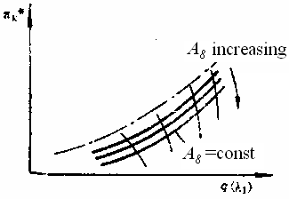
3.2 Nozzle critical section (Cont'd)
Conclusion:
  ↓A₈⇒↑T₃*, ↑thrust, ↓surge margin. And reversely.
Notes:
由此可得出如下结论：在某一喷管临界截面积下，就有一条共同工作线，喷管临界面积收小，则使得涡轮前燃气温度T₃*上升，推力增加，但共同工作线靠近喘振边界，使喘振裕度减小，反之，当喷管临界截面积放大时，则使得涡轮前燃气温度T₃*下降，
推力减小，但共同工作线则远离喘振边界，使喘振裕度增加。

Slide 28
3. Operating line (Cont'd)
3.3 Influence of p₁*／p₀
  Pressure rise by speed
  When atmosphere p₀ constant, if σ_{i} (due to flying M) decreases p₁*, nozzle throat may not be in critical condition and π_{T}* may not be constant. But we want n to be constant, so we need add fuel and T₃* becomes higher.
Notes:
速度冲压p₁*／p₀对共同工作线的影响
在调节规律的讨论中，曾提到喷管喉道达到临界的条件下，进口总压并不影响沿流程各截面上的总温和所有相似参数。上面两点也是在这一条件下得出的。
所以要讨论速度冲压p₁*／p₀对共同工作线的影响

Slide 29
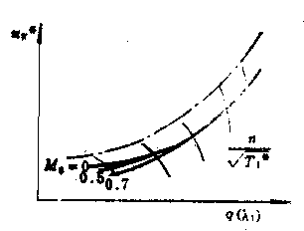
3.3 Influence of p₁*／p₀ (Cont'd)
  When M₀ is high (>0.7) and p₁* is high enough so that throat is always in critical condition with n／√T₁*, only one line.
  For lower n and M₀,
  lines are separated.
  Lower M₀, forked
  point is higher (n) ,
  ex. (n／√T₁*)／(n／√T₁*)_{d}
  =0.95 for M₀=0.
Notes:
当M数较低时，随着n／√T₁*下降到一定程度，喷管喉道开始处于亚临界工作状态，工作线离开M₀=0.7曲线，如M₀=0.5的曲线。
飞行M数越低，共同工作线越早离开，如飞行M数等于0时的共同工作线。这说明在离开设计的n／√T₁*之后，如当( n／√T₁*)／(n／√T₁* )_{d}
=0.95时，喷管就不再处于临界状态工作了。

Slide 30
3. Operating line (Cont'd)
3.4. Operating line in generic performance map
  Since compressor is the most unstable component, the operation line of a engine is drawn on
  its compressor
  performance map.
Notes:
共同工作线在压气机通用特性图上的表示
作为整台发动机的共同工作线本来应当全面地反映发动机的各部件的工作或者在每一部件特性图上都作出共同工作线。但因为压气机对整台发动机影响最大，特别是对可靠工作和效率变化的影响，压气机是最为突出的。所以整机的共同工作线往往绘制在压气机通用特性图上。

Slide 31
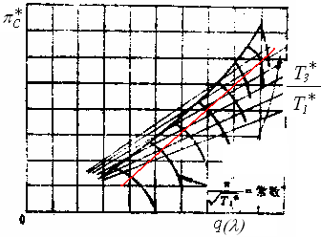
3. Operating line (Cont'd)
3.5. Influence of T₃*
  In compressor performance map, equal T₃*/T₁* lines are radials from the origin (π=0, q(λ)=0) .
Intersection points of those
lines and working line
determine T₃*.
Notes:
从发动机可靠工作的角度来说，涡轮前燃气温度T₃ *是不可忽视的。在压气机通用特性图上，等T₃*/T₁*线是一族从原点出发的辐射线，对于一定的压气机和涡轮，这族辐射线中任一确定的T3*/T1*射线的斜率主要决定于涡轮导向器的出口面积。

Slide 32
3. Operating line (Cont'd)
3.6. Purpose of working line
  Obtained form components’ characteristics by calculation or from tests’ results.
  To know engine’s working conditions such as surge margin, T₃*, compressor efficiency.
  To determine altitude, speed and rotation characteristics.

Slide 33
3. Operating line (Cont'd)
3.7. Influence of adjustment rule
  Finally, the line depends on the adjustment rule. Different rule gives different working lines.
Notes:
与调节规律的关系
最后，还应当着重指出，共同工作线与调节规律有密切关系。不同的调节规律，在同一压气机通用特性图上将有不同的共同工作线。

Slide 34
§4.2 Characteristics
Product specifications provided to aircraft builders
Obtained by tests
  Test bench on ground
  High altitude test bench
  Flying test
Obtained by computation
  In progress

Slide 35
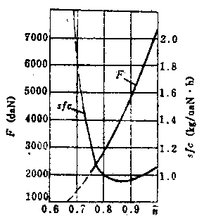
§4.2 Characteristics (Cont’d)
1. Rotation characteristics
  1.1. For engine of unchangeable geometry
    Thrust When at max n, T₃* and π_{C}* are max too, and T*, p* and q_{m} in nozzle also reach max values, thrust is max.
    With n↓, thrust↓.
Notes:
一、转速特性
1. 几何面积不可调发动机的转速特性
推力 当发动机在最大转速，即最大状态工作时，涡轮前燃气温度T₃*和压气机的压比π_{K}*为最高，这时候喷管出口的总压、总温、流量都达最高值，因而推力也最大。随着转速下降，上述参数也都下降，因而推力也下降。

Slide 36
1.1. For unchangeable geometry
    In general, at high n, q_{m} is proportional to n, and T₃*, T₄* are proportional to n². This results in thrust proportional to n³.
    At high n, thrust variation with n is evidently significant.
Notes:
概略分析指出：在高转速下，流量正比于转速，压气机的功，涡轮前后的燃气温度T₃*和T₄*正比于转速的平方。其结果是推力正比于转速的立方。由此可知，在高转速下，推力变化剧烈的情况是显然的。

Slide 37
1.1. For unchangeable geometry
    sfc When n↓ from max by reducing fuel, since in this time π_{C}*, q_{m} are still high, sfc↓ usually 3%～5% less.
    When n↓ continually,
    working point is far off
    design point, π_{C}* is low,
    compressor and turbine
    work at low efficiency
    so that sfc ↑.
Notes:
单位燃油消耗率 随转速离开最大状态，单位燃油消耗率开始是下降的。这是由于压气机压比π_{C}*还较高，涡轮前燃气温度正比于转速的平方而下降，流量和相对M数有所下降，改善了压气机的工作状况，使压气机的效率有所提高(设计工作点一般不是压气机效率的最高点)，其结果是使单位燃油消耗率有所下降，一般可下降3%～5%。
随后，当转速继续下降时，由于偏离设计状态较远，压气机和涡轮的效率都要下降。而且压气机压比也大大下降，单位燃油消耗率随之上升。

Slide 38
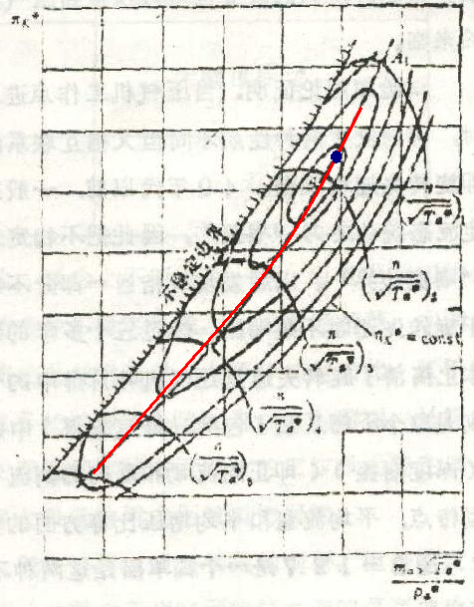

Slide 39
1.1. For unchangeable geometry
    T₃* At high n, T₃*↓ with n.
    But at low n (small thrust), because compressor and turbine work at low efficiency, high T₃* is needed to maintain rotation. In this case, q_{m} is low.

Slide 40
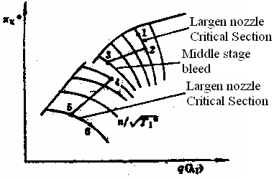
1. Rotation characteristics (Cont'd)
  1.2. For variable nozzle and middle stage bleeding
    Only one working line for unchangeable geometry is easy to reach surge line.
    Here is performance map
    having 3 jumps.
Notes:
可变喷管临界截面和压气机中间级放气的发动机转速特性
几何不变的发动机在一定的调节规律下，只能有一条共同工作线，容易走到喘振边界。
图中的转速特性就不同于几
何不变的发动机。在转速特
性上相应地表示出三个突变：

Slide 41
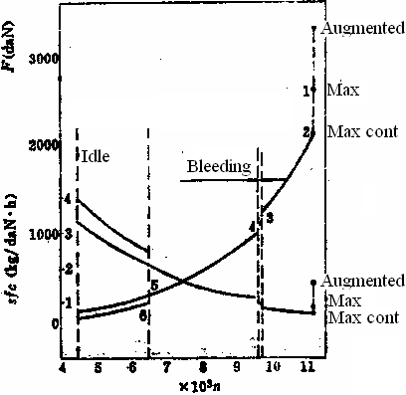
1.2. For variable nozzle (Cont'd)
    ①Largen nozzle critical section, working point from 1 to 2, thrust↓, sfc↓ or a little.

Slide 42
1.2. For variable nozzle (Cont'd)
    ②n↓ continually. Then open bleeding device, working point from 3 to 4, thrust↓,
    sfc↑

Slide 43
1.2. For variable nozzle (Cont'd)
    ③Largen again nozzle, working point from 5 to 6, thrust↓, sfc↑.

Slide 44
1. Rotation characteristics (Cont'd)
  1.3. Engine ratings
    Maximum In this rating, T₃* reaches max and thrust too (without afterburner). Every part is working under extreme condition, so duration time is limited (5～l0min). Normally it is used when taking off.
Notes:
3. 发动机的基本工作状态
最大状态 在这一状态下，发动机的转速和涡轮前燃气温度都达最大值，因而推力也最大。由于在这一状态下发动机各部件承受最大的机械负荷和热负荷，因此要严格地限制连续工作的时间，一般不超过5～l0min。最大状态一般只用于起飞。对于歼击机来说，还用于短时间的爬升和加速。

Slide 45
1.3. Engine ratings (Cont’d)
    Maximum continuous The thrust is about 85%～90% max thrust. Some engines can work continuously on this rating, but some still have time limitation ex. 30～60min for high speed flying.
Notes:
通常规定推力为最大推力的85%～90%时，为发动机的额定状态。从最大状态到额定状态，不同的发动机，有采用沿共同工作线转速下降，涡轮前燃气温度下降，也有采用保持转速不变，通过放大喷口临界面积使涡轮前燃气温度下降的，有的发动机额定状态可连续使用，但有的发动机仍有时间限制，如连续工作时间不超过30～60min。额定状态一般用于爬升。对歼击机来说还用于高速平飞。

Slide 46
1.3. Engine ratings (Cont’d)
    Cruise The thrust is about 65%～75% max thrust. In this condition, n, T₃* and sfc are low. There is no limitation, it can be used for long distance flight.
Notes:
通常规定推力为最大推力的65%～75%时，为发动机的巡航状态。在这一状态下，转速、涡轮前燃气温度以及单位燃油消耗率都较低，在寿命期内连续使用时间不限，因此适宜于用作长时间的远距离航行。

Slide 47
1.3. Engine ratings (Cont’d)
    Idle This is minimum rotation speed in which engine can rotate stably. The thrust is about 3%～5% max thrust. It’s used when landing. If idle thrust is too great, landing distance will be long.
    There is an limitation for time, normally less than 5min because T₃* is high and cooling is not good.
Notes:
慢车状态 这是发动机能够稳定工作的小转速工作状态。通常规定推力应小于最大推力的3%～5%。慢车状态主要用于飞机的着陆及地面短时间检查发动机工作时使用，慢车推力大了，将增加着陆滑跑距离。慢车状态也有时间限制，一般规定连续工作时间不超过5min。这是因为慢车状态是属于低转速，在前面转速特性中曾指出，这时候涡轮前燃气温度较高，受热部件的冷却情况反不如高转速。这也是慢车状态的转速不能进一步降低的原因之一，也就是转速降低时，涡轮前燃气温度进一步提高，以致不能保证可靠地连续工作。

